Slide 1
Supervised1 Memorization methods
資料科學 Data Science
張家銘 Jia-Ming Chang
政治大學資訊科學系
The slide isonly for educational purposes. If any infringement, please contact me, we will correct immediately.

Slide 2
Copyright declaration 版權說明
Some of the figures in this presentation are taken from "An Introduction to Statistical Learning, with applications in R" (Springer, 2013) with permission from the authors: G. James, D. Witten, T. Hastie and R. Tibshirani.
The web site of the book
The credit of individual is indicated in the bottom part of the slide.
ie.,

Slide 3

Copyright declaration 版權說明
Some of the figures in this presentation are taken from "Practical Data Science with R (Manning, 2019)”
The web site of the book
The credit of individual is indicated in the bottom part of the slide.
ie.,

Slide 4
Copyright declaration 版權說明
Some of the figures in this presentation are taken from "R for Data Science” under the Creative Commons Attribution-NonCommercial-NoDerivs 3.0 License.
The web site of the book
The credit of individual is indicated in the bottom part.
ie.,

Slide 5
Recap for the last week

Slide 6
Unsupervised methods
we’ll look at methods to discover unknown relationships in data
two classes of unsupervised methods
Cluster analysis : finds groups in your data with similar characteristics
Hierarchical clustering
k-means
Association rule : mining finds elements or properties in the data that tend to occur together.
Practical Data Science with R by Nina Zumel, John Mount

Slide 7
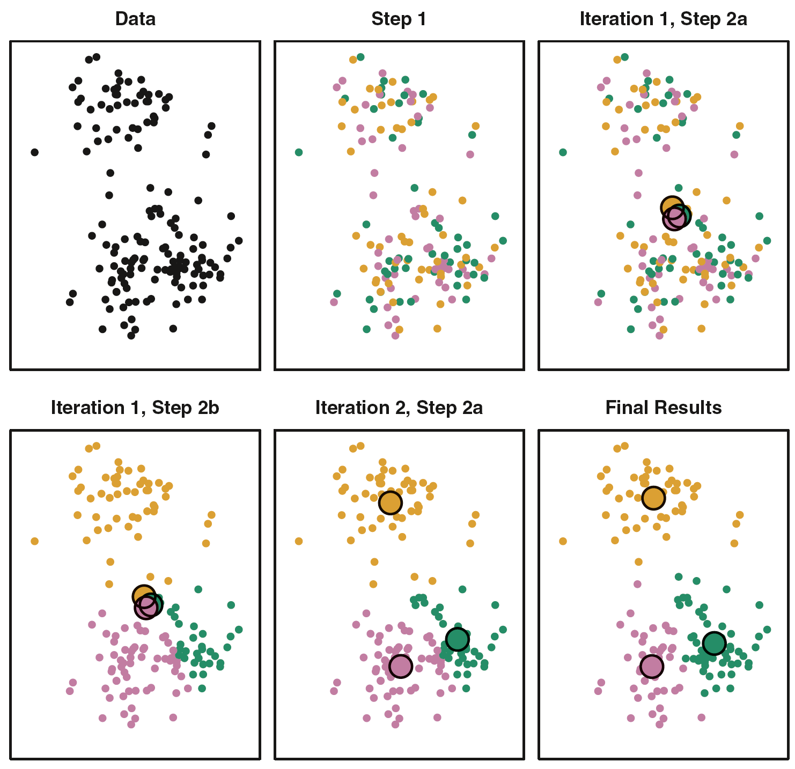
The progress of the K-means algorithm
Figure10.6, An Introduction to Statistical Learning with Applications in R by Gareth James, Daniela Witten, Trevor Hastie, Robert Tibshirani

Slide 8
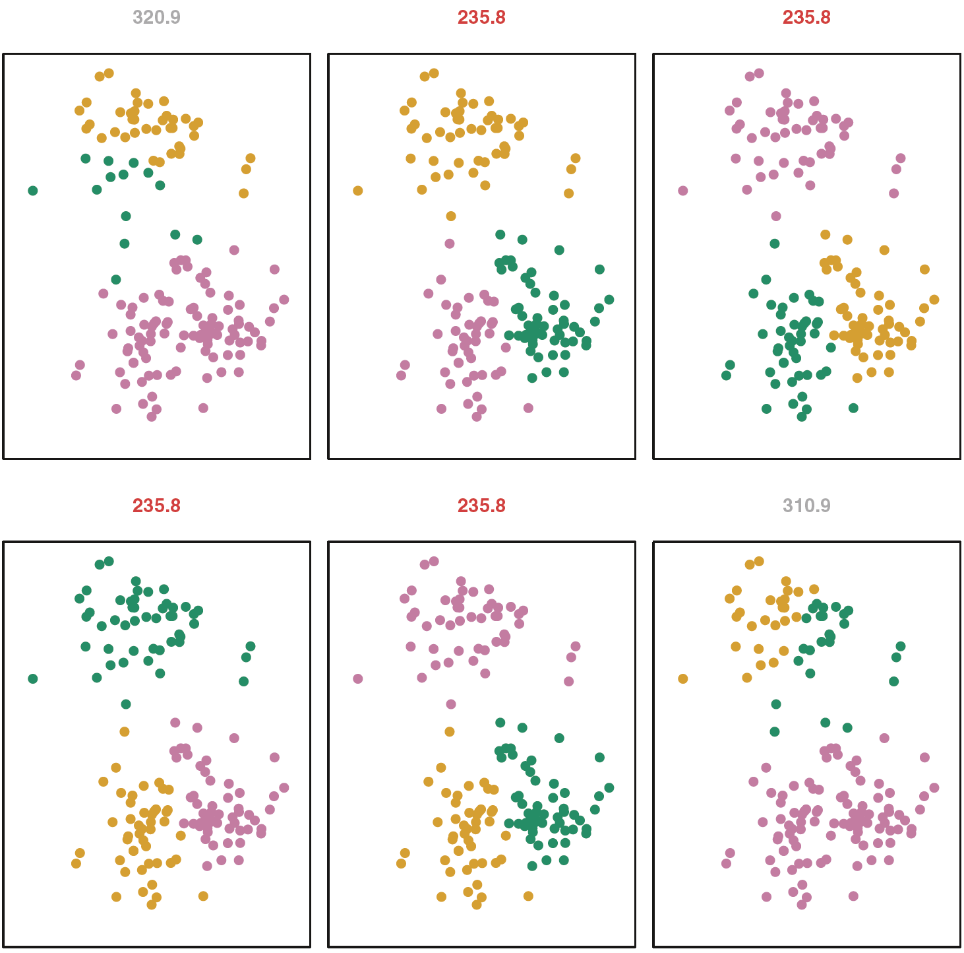
K-means clustering performed 6 times
Figure10.7, An Introduction to Statistical Learning with Applications in R by Gareth James, Daniela Witten, Trevor Hastie, Robert Tibshirani

Slide 9
Whether a given cluster is real?
whether a cluster represents true structure is to see if the cluster holds up under plausible variations in the dataset?
clusterboot (fpc package)
use bootstrap resampling to evaluate how stable a given cluster is
Jaccard coefficient
The Jaccard similarity between two sets A and B
the number of elements in the intersection of A and B / the number of elements in the union of A and B.
Practical Data Science with R by Nina Zumel, John Mount

Slide 10
Cluster stability
The cluster stability of each cluster in the original clustering
the mean value of its Jaccard coefficient over all the bootstrap iterations.
stability value
0.6 <= : unstable.
0.6 ~ 0.75 : measure a pattern in the data, but there isn’t high certainty about which points should be clustered together.
0.85 >= : highly stable (they’re likely to be real clusters).
Practical Data Science with R by Nina Zumel, John Mount

Slide 11
Calinski-Harabasz index – CH.R
B / W : should be maximized at the optimal k
B = BSS(k)/(k-1)
W= WSS(k)/(n-k)
the between-cluster variance (which is essentially the variance of all the cluster centroids from the dataset’s grand centroid) / the total within-cluster variance (the average WSS of the clusters in the clustering)
Practical Data Science with R by Nina Zumel, John Mount

Slide 12
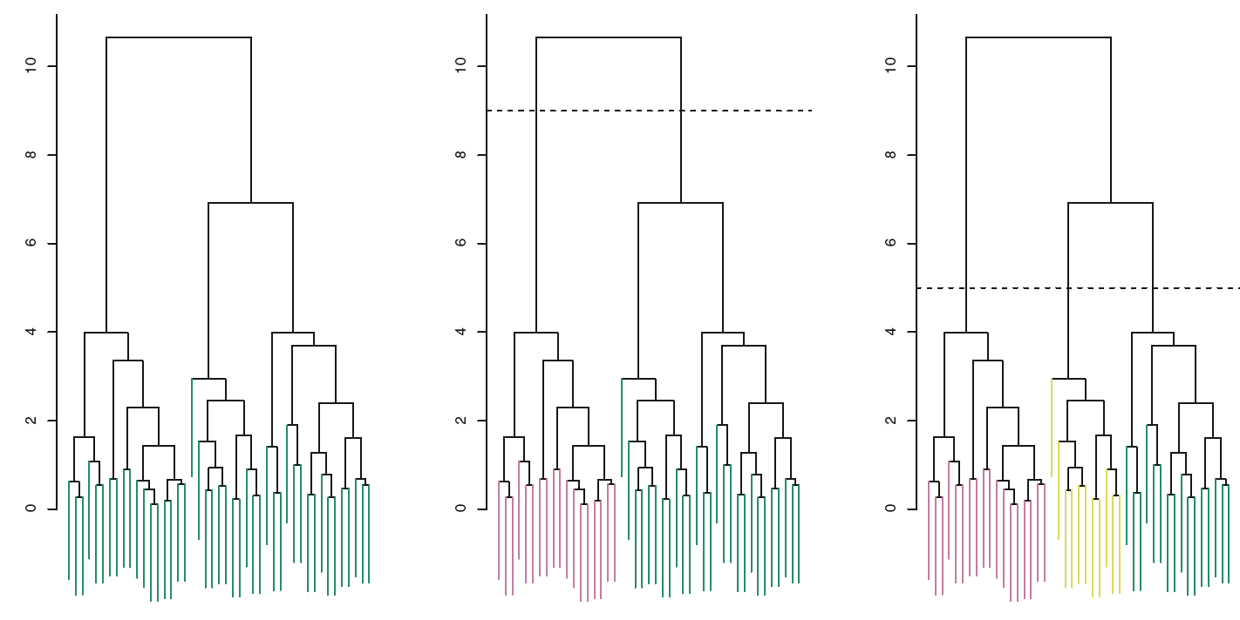
Interpreting a Dendrogram
the vertical axis, indicates how different the two observations are.
Figure10.9, An Introduction to Statistical Learning with Applications in R by Gareth James, Daniela Witten, Trevor Hastie, Robert Tibshirani

Slide 13
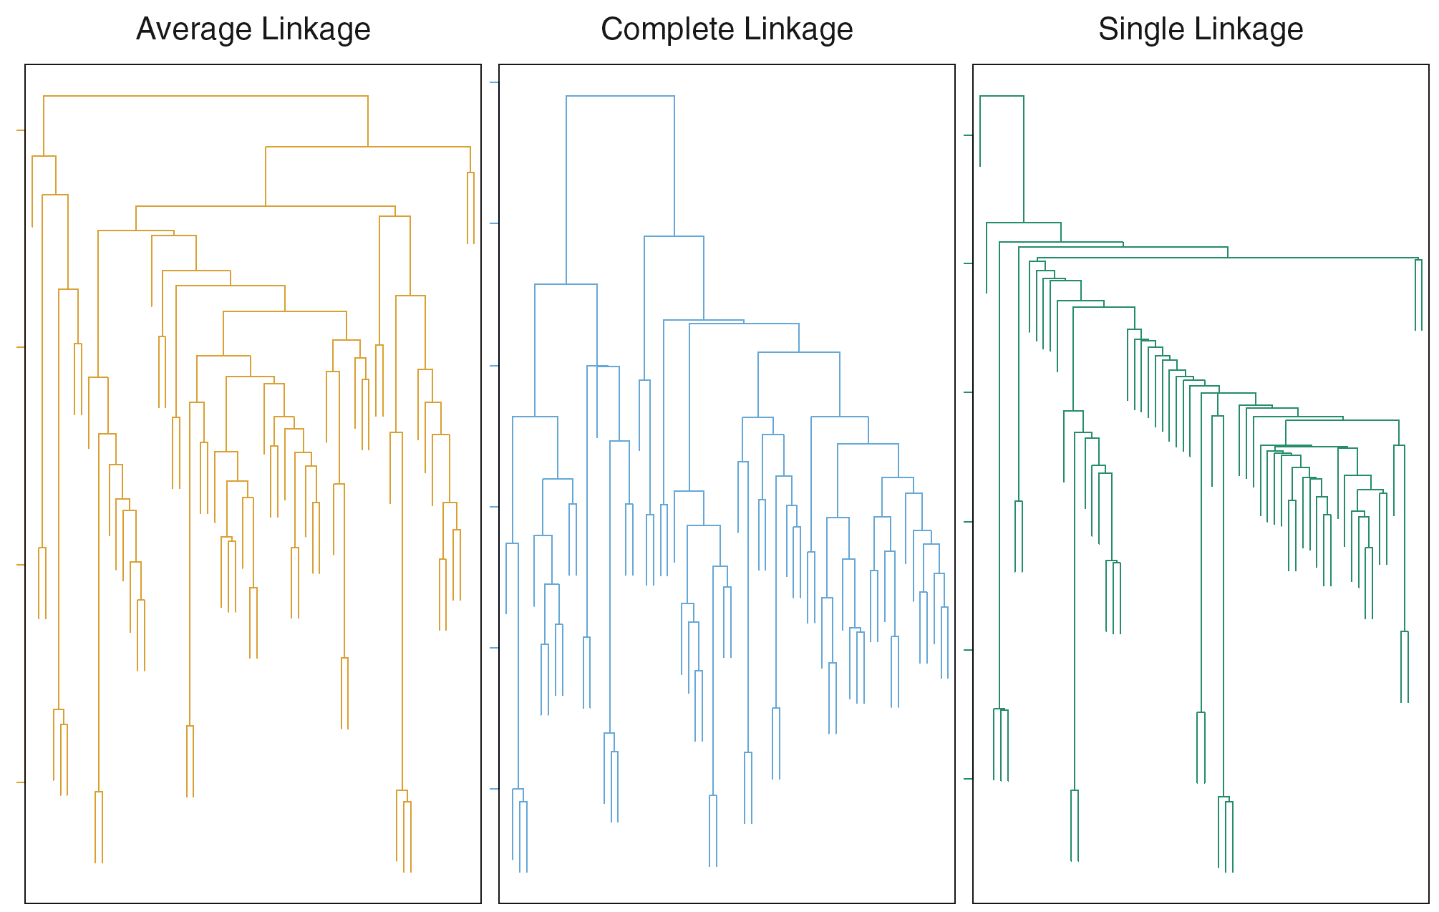
Figure10.12, An Introduction to Statistical Learning with Applications in R by Gareth James, Daniela Witten, Trevor Hastie, Robert Tibshirani

Slide 14
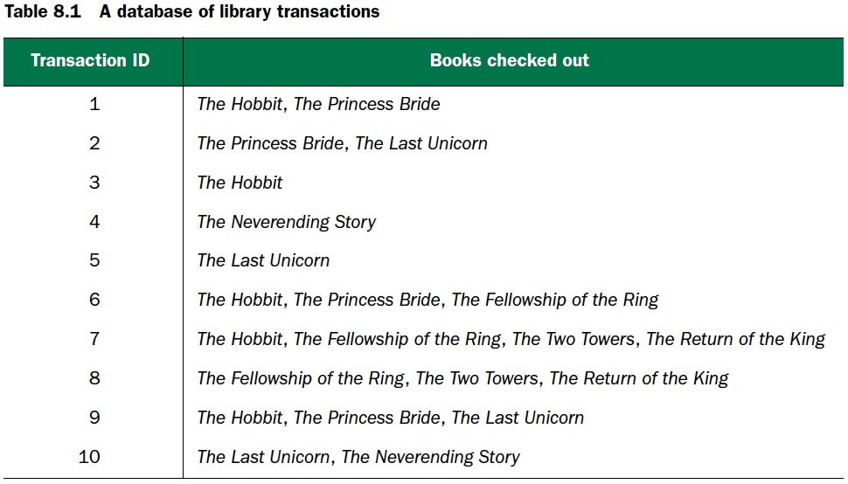
Practical Data Science with R by Nina Zumel, John Mount

Slide 15
3/10
support of the itemset { The Hobbit, The Princess Bride} =
3/5
confidence : “People who check out The Hobbit also check out The Princess Bride” =
3/4
confidence : “People who check out The Princess Bride also check out The Hobbit ” =
Practical Data Science with R by Nina Zumel, John Mount

Slide 16
Chp. 6: Memorization methods
Chp. 2.2.3 The classification setting

Slide 17
Memorization methods
Building single-variable models
Cross-validated variable selection
Building basic multivariable models
nearest neighbor
naive Bayes
Practical Data Science with R by Nina Zumel, John Mount

Slide 18
The Conference on Knowledge Discovery and Data Mining (KDD) Cup 2009
customer relationship management.
Input: The contest supplied 230 facts about 50,000 credit card accounts
Goals: predict
churn : predict account cancellation
appetency : the innate tendency to use new products and services
upselling : willingness to respond favorably to marketing pitches
Practical Data Science with R by Nina Zumel, John Mount

Slide 19
Preparing the KDD data for analysis
KDD2009/KDD2009.R
d <- read.table('orange_small_train.data.gz',header=T, sep='\t', na.strings=c('NA',''))
churn <- read.table('orange_small_train_churn.labels.txt', header=F,sep='\t')
d$churn <- churn$V1
Practical Data Science with R by Nina Zumel, John Mount

Slide 20
Preparing the KDD data for analysis
appetency <- read.table('orange_small_train_appetency.labels.txt', header=F,sep='\t')
d$appetency <- appetency$V1
upselling <- read.table('orange_small_train_upselling.labels.txt', header=F,sep='\t')
d$upselling <- upselling$V1
Practical Data Science with R by Nina Zumel, John Mount

Slide 21
Preparing the KDD data for analysis
Split data into train and test subsets
set.seed(729375)
d$rgroup <- runif(dim(d)[[1]])
dTrainAll <- subset(d,rgroup<=0.9)
dTest <- subset(d,rgroup>0.9)
Practical Data Science with R by Nina Zumel, John Mount

Slide 22
Preparing the KDD data for analysis
Identify features
outcomes=c('churn','appetency','upselling')
vars <- setdiff(colnames(dTrainAll), c(outcomes,'rgroup'))
catVars <- vars[sapply(dTrainAll[,vars],class) %in% c('factor','character')]
numericVars <- vars[sapply(dTrainAll[,vars],class) %in% c('numeric','integer')]
rm(list=c('d','churn','appetency','upselling'))
Practical Data Science with R by Nina Zumel, John Mount

Slide 23
Preparing the KDD data for analysis
Identify outputs
outcome <- 'churn'
pos <- '1'
Practical Data Science with R by Nina Zumel, John Mount

Slide 24
Preparing the KDD data for analysis
Further split training data into training and calibration.
useForCal <- rbinom(n=dim(dTrainAll)[[1]],size=1,prob=0.1)>0
dCal <- subset(dTrainAll,useForCal)
dTrain <- subset(dTrainAll,!useForCal)
Practical Data Science with R by Nina Zumel, John Mount

Slide 25
Preparing the KDD data for analysis
load('KDD2009.Rdata')
Practical Data Science with R by Nina Zumel, John Mount

Slide 26
Subsample to prototype quickly
Often the data scientist will be so engrossed with the business problem, math, and data that they forget how much trial and error is needed.
It’s often an excellent idea to first work on a small subset of your training data, so that it takes seconds to debug your code instead of minutes.
Don’t work with expensive data sizes until you have to.
Practical Data Science with R by Nina Zumel, John Mount

Slide 27
Building single-variable models
Using categorical features
Using numeric features

Slide 28
Building single-variable models – Using categorical features

Slide 29
Using categorical features
KDD2009/sinVal_cat.R
Plotting churn grouped by variable 218 levels
table218 <- table(
Var218=dTrain[,'Var218'],
churn=dTrain[,outcome],
useNA='ifany')
print(table218)
Practical Data Science with R by Nina Zumel, John Mount

Slide 30
Using categorical features
Churn rates grouped by variable 218 codes
print(table218[,2]/(table218[,1]+table218[,2]))
Practical Data Science with R by Nina Zumel, John Mount

Slide 31
Take Var200 as example
v<-"Var200"
outCol<-dTrain[,outcome]
varCol<-dTrain[,v]
appCol<-dTest[,v]
Practical Data Science with R by Nina Zumel, John Mount

Slide 32
Take Var200 as example
pPos <- sum(outCol==pos)/length(outCol)
naTab <- table(as.factor(outCol[is.na(varCol)]))
pPosWna <- (naTab/sum(naTab))[pos]
vTab <- table(as.factor(outCol),varCol)
pPosWv <- (vTab[pos,]+1.0e-3*pPos)/(colSums(vTab)+1.0e-3)
pred <- pPosWv[appCol]
pred[is.na(appCol)] <- pPosWna
pred[is.na(pred)] <- pPos
Practical Data Science with R by Nina Zumel, John Mount

Slide 33
Function to build single-variable models for categorical variables
mkPredC <- function(outCol,varCol,appCol) {
pPos <- sum(outCol==pos)/length(outCol)
naTab <- table(as.factor(outCol[is.na(varCol)]))
pPosWna <- (naTab/sum(naTab))[pos]
vTab <- table(as.factor(outCol),varCol)
pPosWv <- (vTab[pos,]+1.0e-3*pPos)/(colSums(vTab)+1.0e-3)
pred <- pPosWv[appCol]
pred[is.na(appCol)] <- pPosWna
pred[is.na(pred)] <- pPos
pred
}
Practical Data Science with R by Nina Zumel, John Mount

Slide 34
Applying single-categorical variable models to all of our datasets
for(v in catVars) {
pi <- paste('pred',v,sep='')
dTrain[,pi] <- mkPredC(dTrain[,outcome],dTrain[,v],dTrain[,v])
dCal[,pi] <- mkPredC(dTrain[,outcome],dTrain[,v],dCal[,v])
dTest[,pi] <- mkPredC(dTrain[,outcome],dTrain[,v],dTest[,v])
}
Practical Data Science with R by Nina Zumel, John Mount

Slide 35
Scoring categorical variables by AUC
library('ROCR')
calcAUC <- function(predcol,outcol) {
perf <- performance(prediction(predcol,outcol==pos),'auc')
as.numeric(perf@y.values)
}
Practical Data Science with R by Nina Zumel, John Mount

Slide 36
Scoring categorical variables by AUC
for(v in catVars) {
pi <- paste('pred',v,sep='')
aucTrain <- calcAUC(dTrain[,pi],dTrain[,outcome])
if(aucTrain>=0.8) {
aucCal <- calcAUC(dCal[,pi],dCal[,outcome])
print(sprintf("%s, trainAUC: %4.3f calibrationAUC: %4.3f", pi,aucTrain,aucCal))
}
}
What is the most promising variable?
Practical Data Science with R by Nina Zumel, John Mount

Slide 37
Building single-variable models - Using numeric features

Slide 38
Building single-variable models : Using numeric features
bin the numeric feature into a number of ranges
quantile()
cut()
Practical Data Science with R by Nina Zumel, John Mount

Slide 39
Take Var7 as example
v<-"Var7"
outCol<-dTrain[,outcome]
varCol<-dTrain[,v]
appCol<-dTrain[,v]

Slide 40
Take Var7 as example
cuts <- unique(as.numeric(quantile(varCol,
probs=seq(0, 1, 0.1),na.rm=T)))
varC <- cut(varCol,cuts,include.lowest=T)
appC <- cut(appCol,cuts, include.lowest=T)
mkPredC(outCol,varC,appC)
Practical Data Science with R by Nina Zumel, John Mount

Slide 41
Building single-variable models : Using numeric features
KDD2009/sinVal_num.R
mkPredN <- function(outCol,varCol,appCol) {
cuts <- unique(as.numeric(quantile(varCol,
probs=seq(0, 1, 0.1),na.rm=T)))
varC <- cut(varCol,cuts)
appC <- cut(appCol,cuts)
mkPredC(outCol,varC,appC)
}
Practical Data Science with R by Nina Zumel, John Mount

Slide 42
Scoring numeric variables by AUC
for(v in numericVars) {
pi <- paste('pred',v,sep='')
dTrain[,pi] <- mkPredN(dTrain[,outcome],dTrain[,v],dTrain[,v])
dTest[,pi] <- mkPredN(dTrain[,outcome],dTrain[,v],dTest[,v])
dCal[,pi] <- mkPredN(dTrain[,outcome],dTrain[,v],dCal[,v])
aucTrain <- calcAUC(dTrain[,pi],dTrain[,outcome])
if(aucTrain>=0.55) {
aucCal <- calcAUC(dCal[,pi],dCal[,outcome])
print(sprintf("%s, trainAUC: %4.3f calibrationAUC: %4.3f", pi,aucTrain,aucCal))
}
}
Which variable is the best? How to check?
Practical Data Science with R by Nina Zumel, John Mount

Slide 43
Plotting variable performance
ggplot(data=dCal) +
geom_density(aes(x=predVar126,color=as.factor(churn)))
ggplot(data=dCal) + geom_density(aes(x=predVar81,color=as.factor(churn)))
Practical Data Science with R by Nina Zumel, John Mount

Slide 44
Dealing with missing values in numeric variables?
two-step process
for each numeric variable, introduce a new advisory variable
1 : when the original variable had a missing value
0 : otherwise.
replace all missing values of the original variable with 0
Practical Data Science with R by Nina Zumel, John Mount

Slide 45
Using cross-validation to estimate effects of overfitting
var <- 'Var217'
aucs <- rep(0,100)
for(rep in 1:length(aucs)) {
useForCalRep <- rbinom(n=dim(dTrainAll)[[1]],size=1,prob=0.1)>0
predRep <- mkPredC(dTrainAll[!useForCalRep,outcome],
dTrainAll[!useForCalRep,var],
dTrainAll[useForCalRep,var])
aucs[rep] <- calcAUC(predRep,dTrainAll[useForCalRep,outcome])
}
mean(aucs)
sd(aucs)
Practical Data Science with R by Nina Zumel, John Mount

Slide 46
Using cross-validation to estimate effects of overfitting
without for() loop
fCross <- function() {
useForCalRep <- rbinom(n=dim(dTrainAll)[[1]],size=1,prob=0.1)>0
predRep <- mkPredC(dTrainAll[!useForCalRep,outcome],
dTrainAll[!useForCalRep,var],
dTrainAll[useForCalRep,var])
calcAUC(predRep,dTrainAll[useForCalRep,outcome])
}
aucs <- replicate(100,fCross())
Practical Data Science with R by Nina Zumel, John Mount

Slide 47
replicate v.s. for loop
ptm <- proc.time()
aucs <- replicate(100,fCross())
proc.time() - ptm
ptm <- proc.time()
aucs <- rep(0,100)
for(rep in 1:length(aucs)) {
useForCalRep <- rbinom(n=dim(dTrainAll)[[1]],size=1,prob=0.1)>0
predRep <- mkPredC(dTrainAll[!useForCalRep,outcome],
dTrainAll[!useForCalRep,var],
dTrainAll[useForCalRep,var])
aucs[rep] <- calcAUC(predRep,dTrainAll[useForCalRep,outcome])
}
proc.time() - ptm
Practical Data Science with R by Nina Zumel, John Mount

Slide 48
replicate v.s. for loop
ptm <- proc.time()
aucs <- replicate(1000,fCross())
proc.time() - ptm
ptm <- proc.time()
aucs <- rep(0,1000)
for(rep in 1:length(aucs)) {
useForCalRep <- rbinom(n=dim(dTrainAll)[[1]],size=1,prob=0.1)>0
predRep <- mkPredC(dTrainAll[!useForCalRep,outcome],
dTrainAll[!useForCalRep,var],
dTrainAll[useForCalRep,var])
aucs[rep] <- calcAUC(predRep,dTrainAll[useForCalRep,outcome])
}
proc.time() - ptm
Practical Data Science with R by Nina Zumel, John Mount

Slide 49
Using cross-validation to estimate effects of overfitting
In some modeling circumstances, training set estimations are good enough (linear regression is often such an example).
In many other circumstances, estimations from a single calibration set are good enough.
In extreme cases (such as fitting models with very many variables or level values), you’re well advised to use replicated cross-validation estimates of variable utilities and model fits.
Practical Data Science with R by Nina Zumel, John Mount

Slide 50
Using cross-validation to estimate effects of overfitting
Automatic cross-validation is extremely useful in all modeling situations, so it’s critical you automate your modeling steps so you can perform cross-validation studies.
Practical Data Science with R by Nina Zumel, John Mount

Slide 51
Building models using many variables
Naive Bayes
k-nearest neighbor

Slide 52
Building models using many variables – Naive Bayes

Slide 53
Using Naive Bayes
y
T or True if the person is employed
F otherwise
evidence (ev1) : the predicate education "High School”
P(ev1|y==T)
conditional probability of ev1, given y==T
P(y==T |ev1)
Practical Data Science with R by Nina Zumel, John Mount

Slide 54
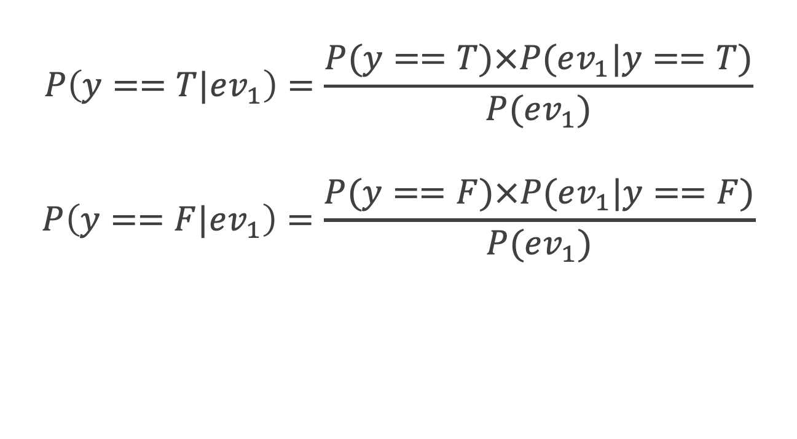
Bayes’ law
$$P\left(y==T|ev_{1}\right)=\frac{P(y==T)×P(ev_{1}|y==T)}{P(ev_{1})}$$
$$P\left(y==F|ev_{1}\right)=\frac{P(y==F)×P(ev_{1}|y==F)}{P(ev_{1})}$$
Practical Data Science with R by Nina Zumel, John Mount

Slide 55
Two-class problem
Class =1
Pr(Y = 1| X = x₀ ) > 0.5
Class = 2
otherwise
Practical Data Science with R by Nina Zumel, John Mount

Slide 56
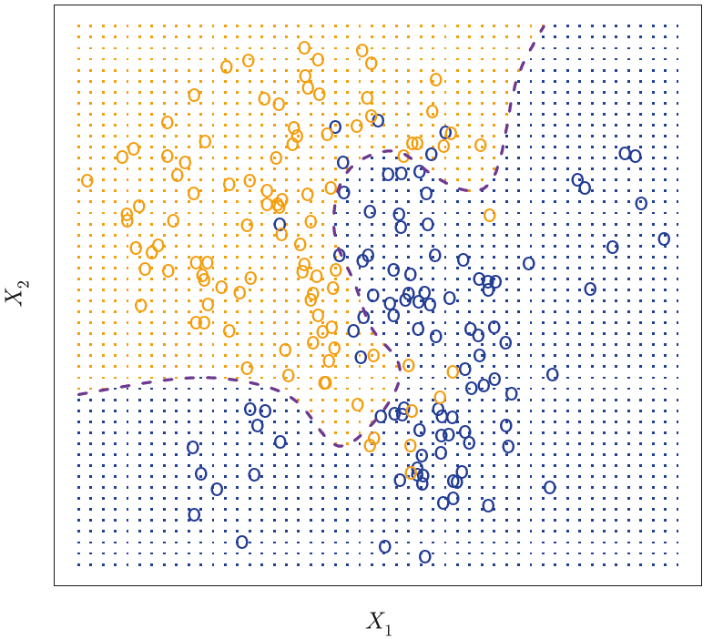
Two groups blue & orange
Figure2.13, An Introduction to Statistical Learning with Applications in R by Gareth James, Daniela Witten, Trevor Hastie, Robert Tibshirani

Slide 57
Two groups blue & orange
Orange shaded region
the set of points Pr(Y=orange|X) > 50%
Blue shaded region
the set of points Pr(Y=orange|X) < 50%
purple dashed line
Pr(Y=orange|X) = 50%
Bayes decision boundary
Figure2.13, An Introduction to Statistical Learning with Applications in R by Gareth James, Daniela Witten, Trevor Hastie, Robert Tibshirani

Slide 58
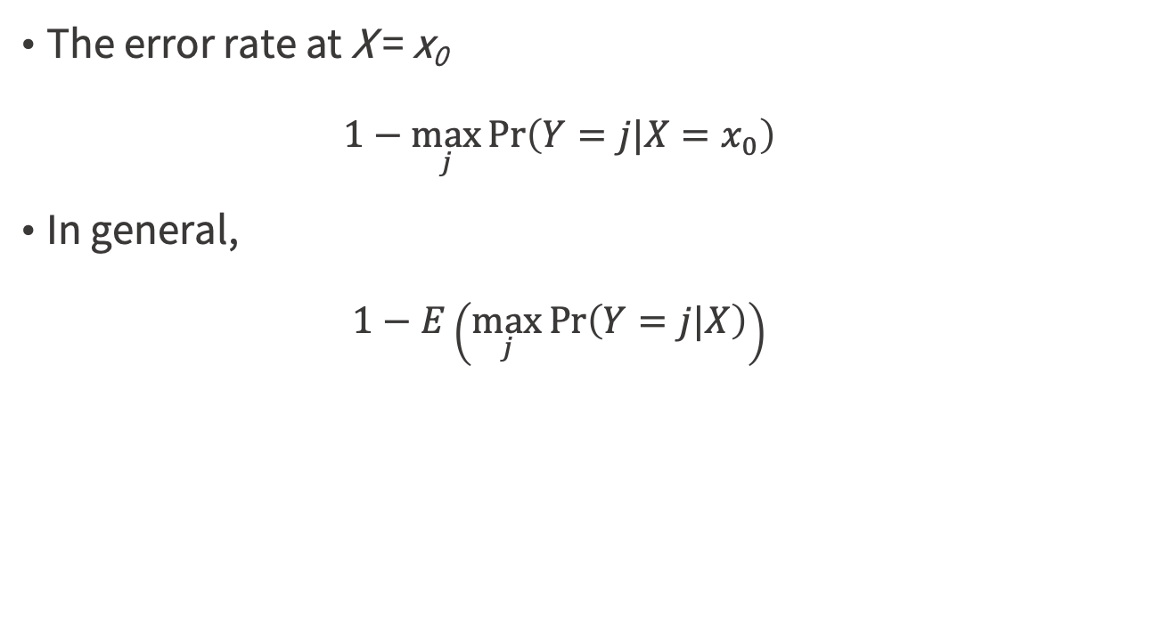
Bayes error rate
The error rate at X = x₀
$$1−\max_{j}{\text{Pr}\left(Y=j|X=x_{0}\right)}$$
In general,
$$1−E\left(\max_{j}{\text{Pr}\left(Y=j|X\right)}\right)$$
An Introduction to Statistical Learning with Applications in R, by Gareth James, Daniela Witten, Trevor Hastie, Robert Tibshirani

Slide 59
Naive Bayes assumption
P(y ==T |ev₁ ... ev_{N})?
all the evidence is conditionally independent of each other for a given outcome
P(ev₁&. . . &ev_{N}|y==T) ≈ P(ev₁|y==T) x . . . xP(ev_{N}|y==T)
P(ev₁&. . . &ev_{N}|y==F) ≈ P(ev₁|y==F) x . . . x P(ev_{N}|y==F)
Practical Data Science with R by Nina Zumel, John Mount

Slide 60
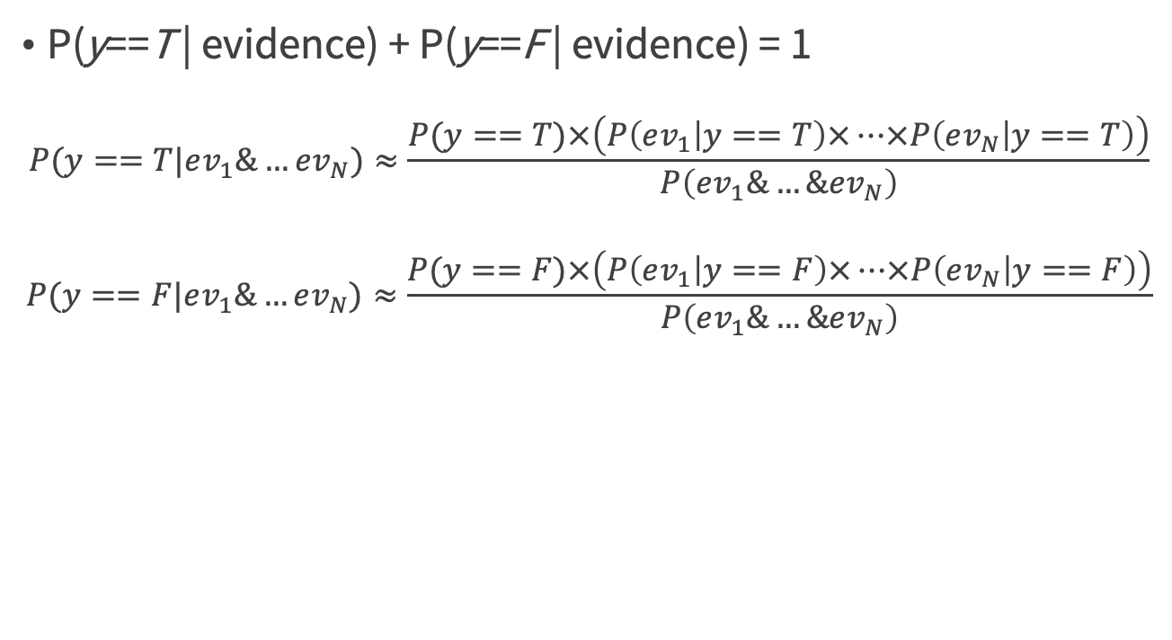
Naive Bayes assumption
P(y==T | evidence) + P(y==F | evidence) = 1
$$P(y==T|ev_{1}\&…ev_{N})≈\frac{P(y==T)×\left(P\left(ev_{1} | y==T\right)×…×P\left(ev_{N} | y==T\right)\right)}{P\left(ev_{1}\&…\&ev_{N}\right)}$$
$$P(y==F|ev_{1}\&…ev_{N})≈\frac{P(y==F)×\left(P\left(ev_{1} | y==F\right)×…×P\left(ev_{N} | y==F\right)\right)}{P\left(ev_{1}\&…\&ev_{N}\right)}$$
Practical Data Science with R by Nina Zumel, John Mount

Slide 61
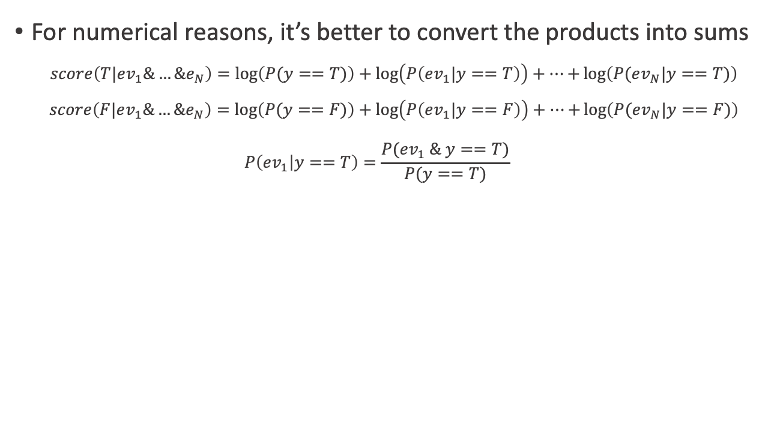
Naive Bayes
For numerical reasons, it’s better to convert the products into sums
$$score\left(T|ev_{1}\&…\&e_{N}\right)=\log\left(P(y==T)\right)+\log\left(P\left(ev_{1}|y==T\right)\right)+…+\log\left(P(ev_{N}|y==T)\right)$$
$$score\left(F|ev_{1}\&…\&e_{N}\right)=\log\left(P(y==F)\right)+\log\left(P\left(ev_{1}|y==F\right)\right)+…+\log\left(P(ev_{N}|y==F)\right)$$
$$P\left({ev}_{1} | y==T\right)=\frac{P({ev}_{1} \& y==T)}{P(y==T)}$$
Practical Data Science with R by Nina Zumel, John Mount

Slide 62
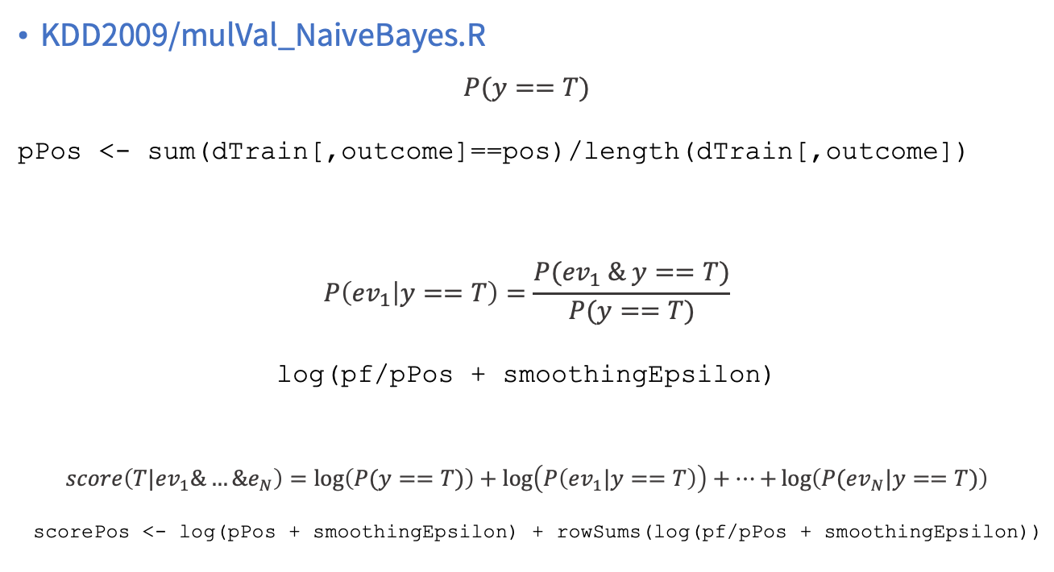
Building a Naive Bayes model
KDD2009/mulVal_NaiveBayes.R
$$P(y==T)$$
pPos <- sum(dTrain[,outcome]==pos)/length(dTrain[,outcome])
$$P\left({ev}_{1} | y==T\right)=\frac{P({ev}_{1} \& y==T)}{P(y==T)}$$
log(pf/pPos + smoothingEpsilon)
$$score\left(T|ev_{1}\&…\&e_{N}\right)=\log\left(P(y==T)\right)+\log\left(P\left(ev_{1}|y==T\right)\right)+…+\log\left(P(ev_{N}|y==T)\right)$$
scorePos <- log(pPos + smoothingEpsilon) + rowSums(log(pf/pPos + smoothingEpsilon))
Practical Data Science with R by Nina Zumel, John Mount

Slide 63
Building a Naive Bayes model
KDD2009/mulVal_NaiveBayes.R
pPos <- sum(dTrain[,outcome]==pos)/length(dTrain[,outcome])
nBayes <- function(pPos,pf) {
pNeg <- 1 - pPos
smoothingEpsilon <- 1.0e-5
scorePos <- log(pPos + smoothingEpsilon) + rowSums(log(pf/pPos + smoothingEpsilon))
scoreNeg <- log(pNeg + smoothingEpsilon) + rowSums(log((1-pf)/(1-pPos) + smoothingEpsilon))
m <- pmax(scorePos,scoreNeg)
expScorePos <- exp(scorePos-m)
expScoreNeg <- exp(scoreNeg-m)
expScorePos/(expScorePos+expScoreNeg)
}
Practical Data Science with R by Nina Zumel, John Mount

Slide 64
Applying and evaluating a Naive Bayes model
pVars <- paste('pred',c(numericVars,catVars),sep='')
dTrain$nbpredl <- nBayes(pPos,dTrain[,pVars])
dCal$nbpredl <- nBayes(pPos,dCal[,pVars])
dTest$nbpredl <- nBayes(pPos,dTest[,pVars])
Practical Data Science with R by Nina Zumel, John Mount

Slide 65
Applying and evaluating a Naive Bayes model
print(calcAUC(dTrain$nbpredl,dTrain[,outcome]))
print(calcAUC(dCal$nbpredl,dCal[,outcome]))
print(calcAUC(dTest$nbpredl,dTest[,outcome]))
Practical Data Science with R by Nina Zumel, John Mount

Slide 66
Using a Naive Bayes package
library('e1071')
lVars <- c(catVars,numericVars)
ff <- paste('as.factor(',outcome,'>0) ~ ', paste(lVars,collapse=' + '),sep='')
nbmodel <- naiveBayes(as.formula(ff),data=dTrain)
dTrain$nbpred <- predict(nbmodel,newdata=dTrain,type='raw')[,'TRUE']
dCal$nbpred <- predict(nbmodel,newdata=dCal,type='raw')[,'TRUE']
dTest$nbpred <- predict(nbmodel,newdata=dTest,type='raw')[,'TRUE']
Practical Data Science with R by Nina Zumel, John Mount

Slide 67
Using a Naive Bayes package
calcAUC(dTrain$nbpred,dTrain[,outcome])
calcAUC(dCal$nbpred,dCal[,outcome])
calcAUC(dTest$nbpred,dTest[,outcome])
Practical Data Science with R by Nina Zumel, John Mount

Slide 68
The property of Naive Bayes
Naive Bayes doesn’t perform any clever optimization, so it can be outperformed by methods like logistic regression and support vector machines.
Naive Bayes is particularly useful when you have a very large number of features that are rare and/or nearly independent.
Document classification: bag-of-words or bag-of-k-grams
Practical Data Science with R by Nina Zumel, John Mount

Slide 69
Building models using many variables - k-nearest neighbor

Slide 70
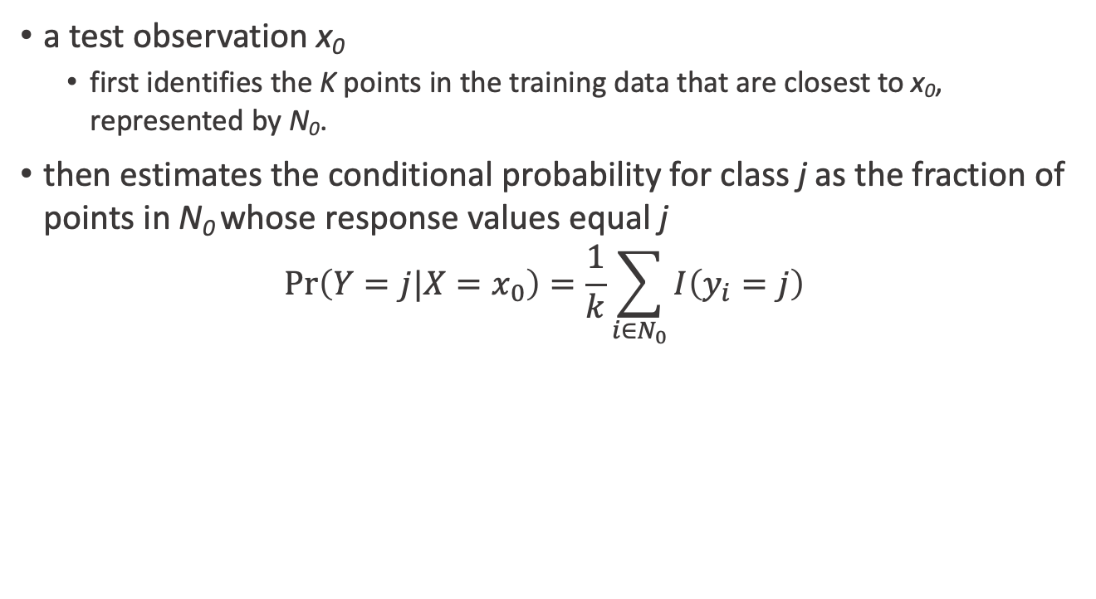
How to conditional distribution of Y given X ?
a test observation x₀
first identifies the K points in the training data that are closest to x₀, represented by N₀.
then estimates the conditional probability for class j as the fraction of points in N₀ whose response values equal j
$$\text{Pr}\left(Y=j|X=x_{0}\right)=\frac{1}{k}\sum_{i∈N_{0}}{I\left(y_{i}=j\right)}$$
An Introduction to Statistical Learning with Applications in R by Gareth James, Daniela Witten, Trevor Hastie, Robert Tibshirani

Slide 71
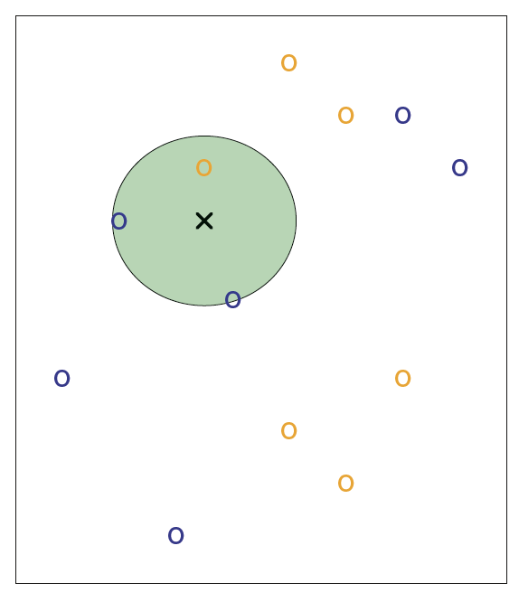
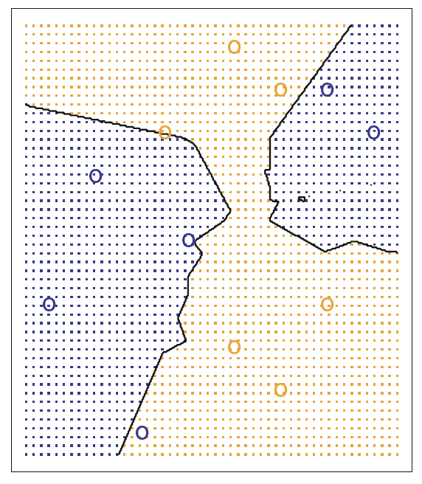
K = 3
Figure2.14, An Introduction to Statistical Learning with Applications in R by Gareth James, Daniela Witten, Trevor Hastie, Robert Tibshirani

Slide 72
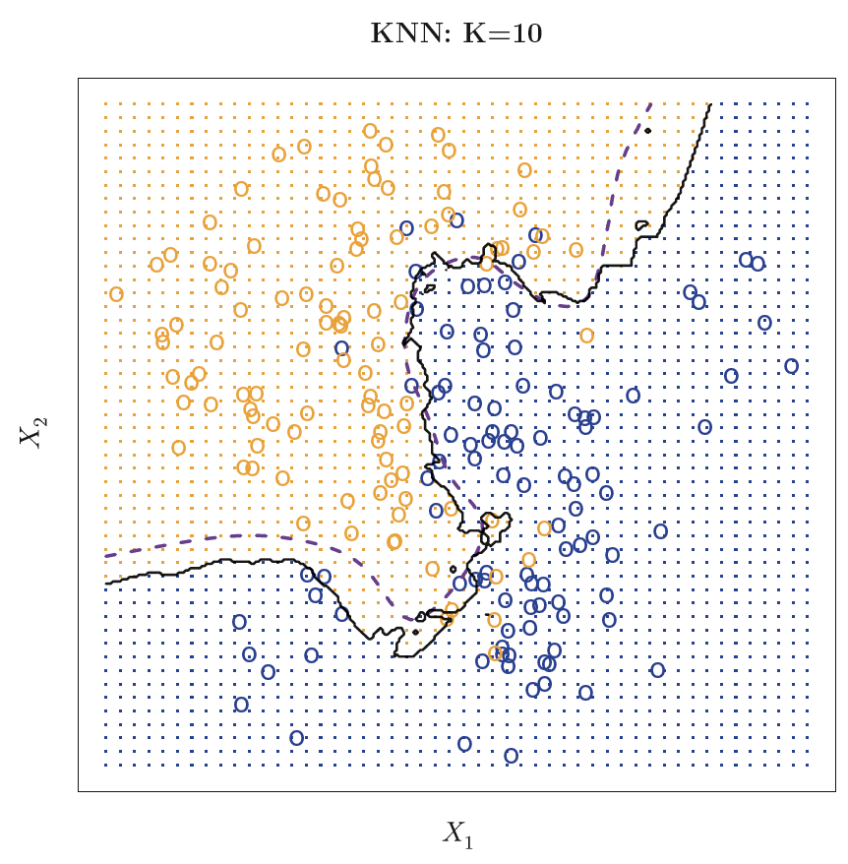
Simulation data by K = 10
error rate
KNN : 0.1363
Bayes: 0.1304
Figure2.15, An Introduction to Statistical Learning with Applications in R by Gareth James, Daniela Witten, Trevor Hastie, Robert Tibshirani

Slide 73
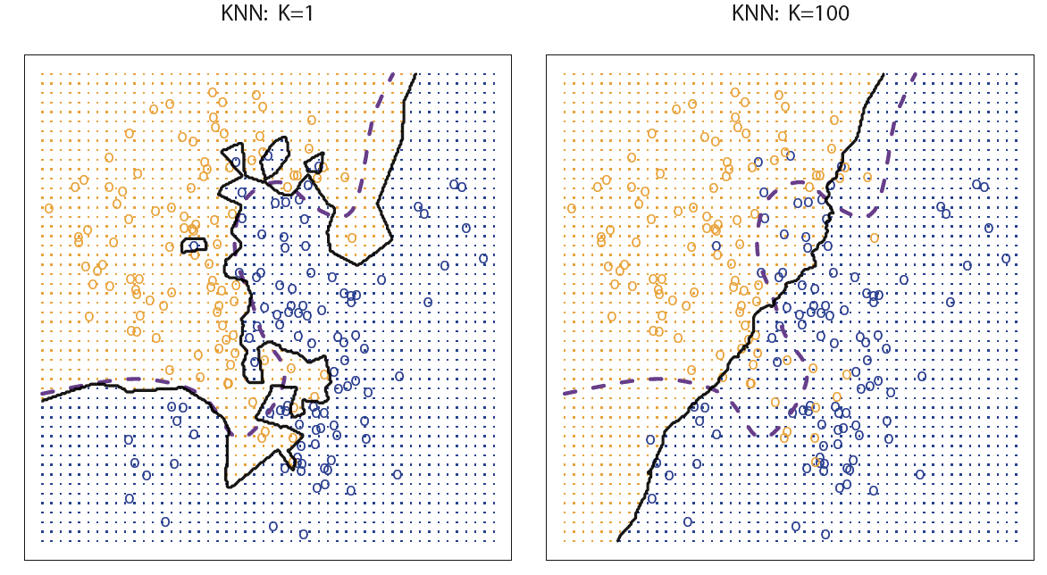
The bigger K, the better?
error= 0. 1695
error= 0. 1925
low-bias but very high-variance
low-variance but high-bias
Figure2.16, An Introduction to Statistical Learning with Applications in R by Gareth James, Daniela Witten, Trevor Hastie, Robert Tibshirani

Slide 74
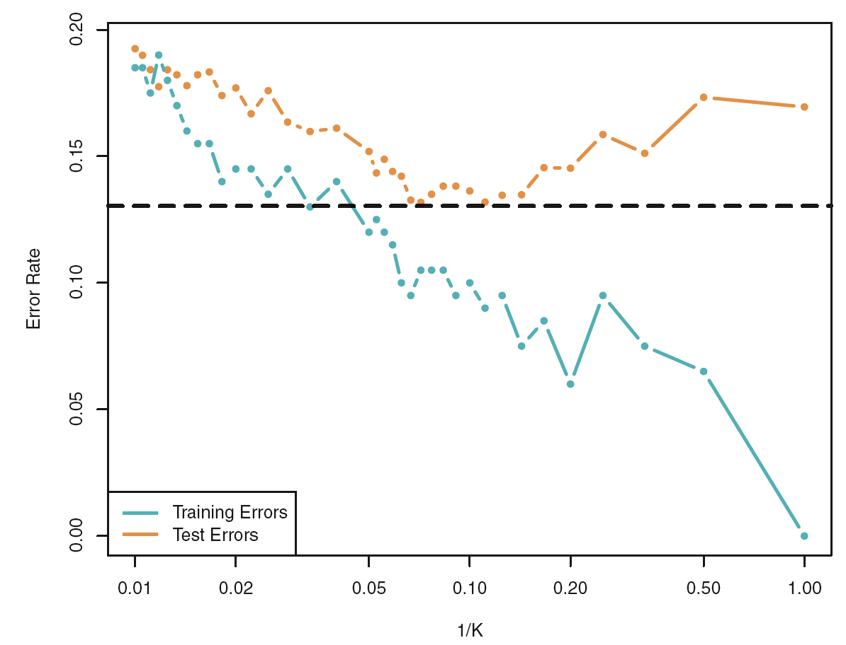
Figure2.17, An Introduction to Statistical Learning with Applications in R by Gareth James, Daniela Witten, Trevor Hastie, Robert Tibshirani

Slide 75
Using nearest neighbor methods
One problem with K-NN is the nature of its concept space?
3-nearest neighbor
=> zero, one, two, or three examples of churn
=> the estimated probability of churn = 0%, 33%, 66%, or 100%.
Practical Data Science with R by Nina Zumel, John Mount

Slide 76
Using nearest neighbor methods
events with unbalanced outcomes (that probabilities not near 50%)
using a large k so KNN can express a useful range of probabilities
have a good chance of seeing 10 positive examples in each neighborhood
around 7% in our training data => 10/0.07 = 142
Practical Data Science with R by Nina Zumel, John Mount

Slide 77
Variable selection
KDD2009/mulVal_knn.R
logLikelyhood <-
function(outCol,predCol) {
sum(ifelse(outCol==pos,log(predCol),log(1-predCol)))
}
Practical Data Science with R by Nina Zumel, John Mount

Slide 78
Variable selection
KDD2009/mulVal_knn.R
selVars <- c()
minStep <- 5
baseRateCheck <- logLikelyhood(dCal[,outcome],
sum(dCal[,outcome]==pos)/length(dCal[,outcome]))
Practical Data Science with R by Nina Zumel, John Mount

Slide 79
Variable selection for categorical variables
for(v in catVars) {
pi <- paste('pred',v,sep='')
liCheck <- 2*((logLikelyhood(dCal[,outcome],dCal[,pi]) -
baseRateCheck))
if(liCheck>minStep) {
print(sprintf("%s, calibrationScore: %g",
pi,liCheck))
selVars <- c(selVars,pi)
}
}
Practical Data Science with R by Nina Zumel, John Mount

Slide 80
Variable selection for numerical variables
for(v in numericVars) {
pi <- paste('pred',v,sep='')
liCheck <- 2*((logLikelyhood(dCal[,outcome],dCal[,pi]) -
baseRateCheck) - 1)
if(liCheck>=minStep) {
print(sprintf("%s, calibrationScore: %g",
pi,liCheck))
selVars <- c(selVars,pi)
}
}
Practical Data Science with R by Nina Zumel, John Mount

Slide 81
Running k-nearest neighbors
library('class')
nK <- 200
knnTrain <- dTrain[,selVars]
knnCl <- dTrain[,outcome]==pos
knnPred <- function(df) {
knnDecision <- knn(knnTrain,df,knnCl,k=nK,prob=T)
ifelse(knnDecision==TRUE,
attributes(knnDecision)$prob,
1-(attributes(knnDecision)$prob))
}
Practical Data Science with R by Nina Zumel, John Mount

Slide 82
Running k-nearest neighbors
print(calcAUC(knnPred(dTrain[,selVars]),dTrain[,outcome]))
print(calcAUC(knnPred(dCal[,selVars]),dCal[,outcome]))
print(calcAUC(knnPred(dTest[,selVars]),dTest[,outcome]))
Practical Data Science with R by Nina Zumel, John Mount

Slide 83
Check the performance
Platting 200-nearest neighbor performance
dCal$kpred <- knnPred(dCal[,selVars])
ggplot(data=dCal) +
geom_density(aes(x=kpred,
color=as.factor(churn),linetype=as.factor(churn)))
Practical Data Science with R by Nina Zumel, John Mount

Slide 84
Check the performance
What do you observe?
Distributions
multimodal are often evidence that there are significant effects we haven’t yet explained.
unimodal or even look normal are consistent with the unexplained effects being simple noise.
What we’re looking for are the two distributions to be unimodal
if not separated, at least not completely on top of each other
Practical Data Science with R by Nina Zumel, John Mount

Slide 85
Check the performance
Plotting the receiver operating characteristic (ROC) curve
plotROC <- function(predcol,outcol) {
perf <- performance(prediction(predcol,outcol==pos),'tpr','fpr')
pf <- data.frame( FPR=perf@x.values[[1]],TPR=perf@y.values[[1]])
ggplot() +
geom_line(data=pf,aes(x=FPR,y=TPR)) +
geom_line(aes(x=c(0,1),y=c(0,1)))
}
print(plotROC(knnPred(dTest[,selVars]),dTest[,outcome]))
Practical Data Science with R by Nina Zumel, John Mount

Slide 86
Summary

Slide 87
AUC
methods | train | calibration | test
Single-variable
categorical variable | 0.830 | 0.565 | 0.551
numerical variable | 0.635 | 0.629 | 0.637
Multivariable
k-NN | 0.744 | 0.711 | 0.718
Naïve Bayes | 0.975 | 0.599 | 0.595
Naïve Bayes - e1071 | 0.464 | 0.554 | 0.567

Slide 88
Single-variable model
Single-variable models can be thought of as being simple summaries of the training data (categorical variables)
=> the model is essentially a contingency table or pivot table
=> essentially organize the training data into a number of subsets indexed by the predictive variable
=> store a summary of the distribution of outcome as their future prediction.
Practical Data Science with R by Nina Zumel, John Mount

Slide 89
Naive Bayes
form their decision by building a large collection of independent single-variable models
Prediction for a given example is just the product of all the applicable single variable model adjustments
Predictions are just sums of appropriate summaries of the original training data.
Practical Data Science with R by Nina Zumel, John Mount

Slide 90
K-nearest neighbor
summaries of the k pieces of training data that are closest to the example to be scored.
KNN models usually store all of their original training data instead of an efficient summary
=> they truly do memorize the training data
Practical Data Science with R by Nina Zumel, John Mount

Slide 91
Summary
Always try single-variable models before trying more complicated techniques.
Single-variable modeling techniques give you a useful start on variable selection.
Always compare your model performance to the performance of your best single-variable model.
Consider decision trees, nearest neighbor, and naive Bayes models as basic data memorization techniques and, if appropriate, try them early in your projects.
Practical Data Science with R by Nina Zumel, John Mount

Slide 92

Thank You Any Question?

